Slide 1


Firmware 101

Slide 2
What is firmware?
Permanent software programmed into a read-only memory
Might be updatable, but might not ever be updated
Firmware typically runs on the ‘bare metal’ of the hardware without an operating system
firmware 101

Slide 3
Goals
Learn the basics of program execution
Get a sense of how data is handled by your CPU
Learn how data gets in and out of your system
Programming basics for dedicated hardware
Learn about development environments
Prevent common pitfalls
Think up snide remarks on the presentation
firmware 101

Slide 4
Program Execution
firmware 101

Slide 5
Running an App - Generic App on a PC
Turtles
Bare Metal CPU
BIOS
Operating System
Device Drivers
Hardware Abstraction Layer
Process Scheduler
Some App
Your App
Some App
Some App
Some App
firmware 101
Notes:
Lots of layers
Everything is very abstracted and hidden so you don’t have to worry about low level stuff

Slide 6
Running an App - Your App in Firmware
Turtles
Bare Metal CPU
Your App
firmware 101
Notes:
As a firmware dev, you have to manage the low level stuff

Slide 7
What’s missing?
Your app is responsible for:
Booting the CPU
Setting up the hardware
Managing execution
Managing memory
Managing device IO
firmware 101
Notes:
So many things...

Slide 8
That’s too much work!
Good news: you don’t need to implement a full operating system
You only need to implement what you want to use
Well, almost...
firmware 101

Slide 9
Firmware: Getting Started
Study the chip docs for how to boot your CPU
Study the chip docs for how to setup IO peripherals
Determine the memory map of your system and write a linker script
Write a crt0
Write your app
firmware 101
Notes:
Crt0 = C Runtime Zero, which sets up the RAM and potentially some of the hardware, and hands control to your app

Slide 10
That’s still too much work!
Good news - most chips have a toolchain or ‘BSP’ (board support package) to do the low level stuff for you.
New list-o-stuff to do:
Study the chip docs for how to setup and interface your desired I/O
Download and install a BSP/Toolchain for your chip
Write your app
firmware 101

Slide 11
Data and Architecture Basics
firmware 101

Slide 12
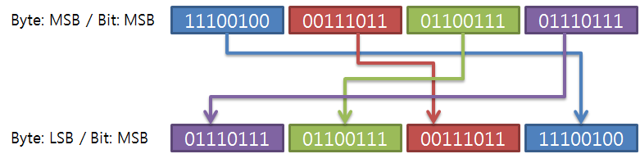
Endianess
Big or Little - Motorola or Intel
‘Network Byte Order’ is Big Endian
Bits in bytes are the same, but mult-byte words get swapped
firmware 101
Notes:
Competing systems for data storage have emerged
Motorola went for Big Endian and Intel went for Little
Network Byte Order is the order of bytes on the wire and has standardized on Big Endian

Slide 13
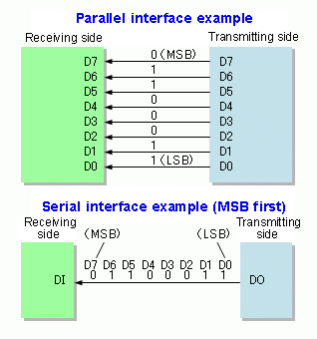
Parallel vs Serial
Serial - Much less wires - Slower - Data usually needs to be buffered
Parallel - Fast - Eats up IO
firmware 101

Slide 14
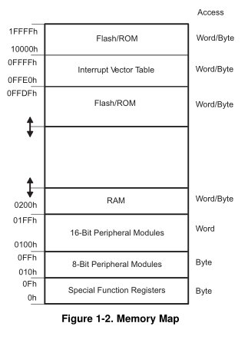
Memory Maps
Different chips are laid out differently
Some areas are read/write, some are read only during program execution
Vectors point to the start of a function
firmware 101
Notes:
Interrupt vectors will be talked about in more detail in a couple of slides

Slide 15
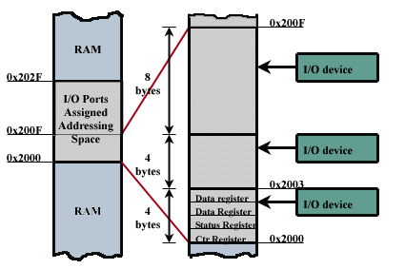
Memory Mapped IO
Sometimes a memory address is really a pointer to some special hardware
Reading/writing to these addresses allow your program to configure the hardware and interact with the outside world
Chip docs typically refer to these addresses as ‘registers’
Your CPU uses registers too
firmware 101

Slide 16
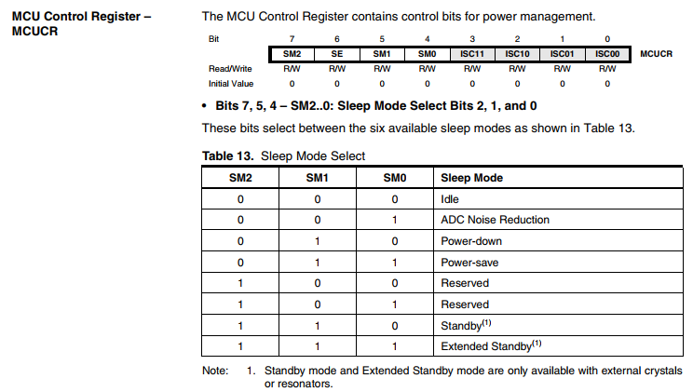
Registers
Bits and bytes
Read? Write? Both?
SM2? SM1? WTF0?
firmware 101

Slide 17
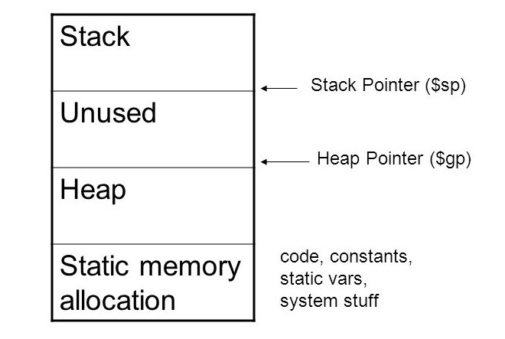
RAM: The Stack and The Heap
Don’t cross the pointers - True for Ghostbusters and embedded dev
Stack grows in one direction, heap in the other - think about caves
Stack is used to track where we are in execution, and to pass vars into a function
Heap is dynamic memory and pre-allocated static memory
firmware 101
Notes:
Stalagmites might reach the ceiling, stalactites hold tight to the ceiling
Pointers are managed by the CPU itself

Slide 18
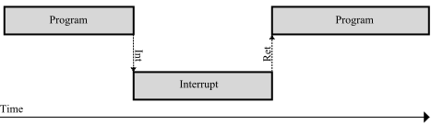
Interrupts
Pauses program execution when some hardware condition is met
CPU jumps to the function pointed to by the interrupt vector table entry
Interrupts need to be handled quickly
firmware 101

Slide 19
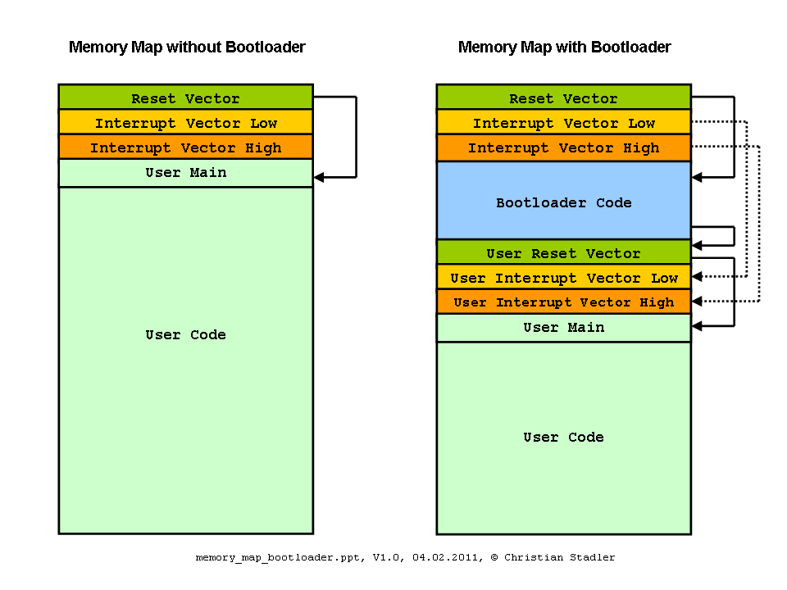

Boot!
CPU jumps from the address in the reset vector
CPU doesn’t care if data is code or data
CPU = honey badger
firmware 101
Notes:
Jumping to the wrong place will lead to wacky results

Slide 20
Peripherals and IO
firmware 101

Slide 21
GPIO
General Purpose Input/Output
The basic building block of getting signals in and out of your CPU - All CPUs have some manner of GPIO
‘Bit banging’ - Cheap, no special hardware needed to emulate some fancy peripheral - Takes lots of CPU processing time for anything non-trivial
Operation is typically as simple and reading/writing a register
Some chips have configurable pull up or pull down resistors too
firmware 101

Slide 22
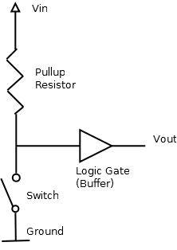
Pull up/down resistor?
Forces a signal to be either 0v or Vcc
Logic circuits only understand high or low!
‘Floating’ is ‘undefined’ ie ‘probably a bug’
firmware 101

Slide 23
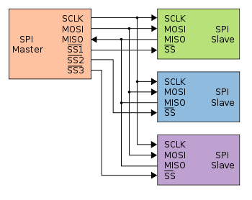
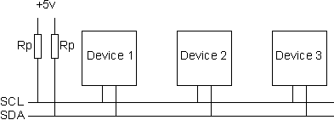
Some other peripherals
SPI - Serial Peripheral Interface - One master, multiple slaves with ‘chip selects’
Serial - RS232/422/485 - Asynchronous, stupid simple - but limited devices on bus
I2C - Inter-integrated Circuit - No master, devices have addresses, no selects
firmware 101

Slide 24
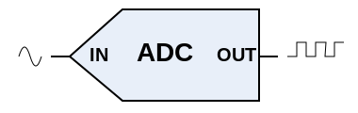
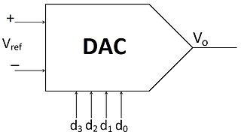
Still more peripherals
ADC - Analog to Digital Convertor - Turn an analog signal into a digital approximation - Speed, bit width, sample and hold, serial/parallel
DAC - Digital to Analog Convertor - ADC, but backwards
CAN, Ethernet, etc, etc...
firmware 101

Slide 25
Programming Basics
firmware 101

Slide 26
Typical program structure
Setup hardware
Enter a never-ending loop waiting for something interesting to happen
Do something amazing when things get interesting
Example:
Set GPIOs for buttons to input. Setup serial port
Wait until user presses a button
Print insults about the user on the serial port
Lather, rinse, repeat from step 2
firmware 101

Slide 27
Polling vs Interrupts
A CPU can only do one thing at a time
Polling requires you periodically check for data - Hard to do other things when you need to go check for something - Easy to write programs that stall until something happens - Absolute timing is hard, relative timing is easy
Interrupts - You have to set them up and write a handler - Things happen in the background and fire the handler when data is ready - “Wait until …” code gets a little more interesting - Great way to set up absolute timers, ie, wall clock
firmware 101
Notes:
It sure seems like computers can do a 1000 things at once, but it’s all smoke and mirrors

Slide 28
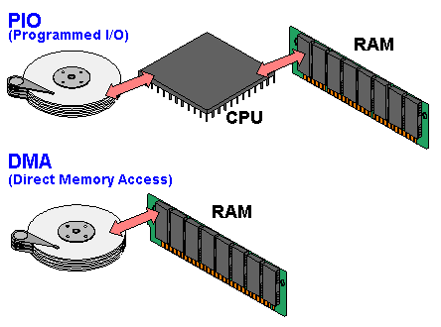
DMA
Direct Memory Access
Bypass the CPU for read/write to a device
Much faster than polled IO
Happens in the background
Not all devices support DMA
firmware 101

Slide 29
Development Environments
firmware 101

Slide 30
Programming Language
Can I use Python/Ruby/Node.js/etc? - Probably not what you want - Will eat up a lot of space just to get you to ‘hello world’
So, assembly only then? - Nah, that’s too painful - Only needed if you need to eek out every last little bit of power or you’re into pain
But I don’t like C! - Tough cookies? - Seriously
firmware 101

Slide 31
IDEs and Toolchains
Arduino IDE - Good for beginners, but very limiting
Chip maker’s IDE - Best chance of support - Likely need to shell out the bucks if you are doing anything more than blinking an LED
GCC - There’s probably a toolchain for it - Lots of developers, but there might be ragged edges and pitfalls
firmware 101

Slide 32
RTOS
Real Time Operating System
Super simple task scheduling and memory management kernel
ChibiOS, MQX, VxWorks, Linux (!), others
Abstracts hardware and data passing - But at the cost of increased complexity and code usage
Makes team development a bit easier
Worth it?
firmware 101

Slide 33
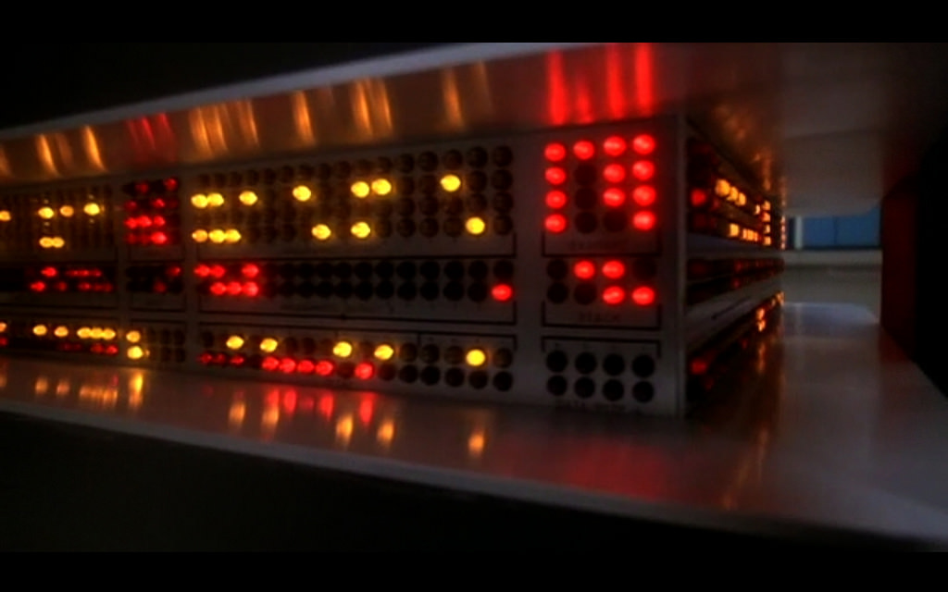
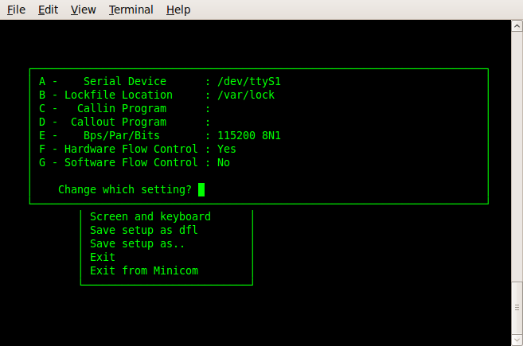
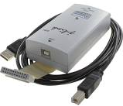
Debugging
Blink an LED - Simple but not much info - Use a block of GPIOs with a logic analyzer for signal timing
Setup a serial port - Can eat up a lot of code space - Not exactly real time, but close
Use JTAG or other chip specific debug interface - Can set breakpoints, alter memory on the fly - Pausing for a breakpoint won’t pause external data streams!
firmware 101

Slide 34
Tips and tricks
malloc() and dynamic memory is not your friend - Static memory allocation protects against memory overruns - Easier to see if you’re going to run out of memory during operation with static analysis
Be super careful about loops and recursion - Easy to get stuck forever in a loop
Limit pointer redirection - Remember the CPU will attempt to execute data as though it was instructions if it gets confused
firmware 101

Slide 35
Tips and tricks
Bad
Good
Code defensively! - Be verbose, avoid syntax shortcuts - Clever, compact code is always harder to debug than verbose, obvious code
Computers make very fast, very accurate mistakes - Try to think like the computer does, not what you want it to do
That thing that will happen like once in a million times will happen every 5 minutes - CPUs run in the mhz
Read NASA’s ‘Rules for Developing Safety Critical Code’ - http://pixelscommander.com/wp-content/uploads/2014/12/P10.pdf
if(condition)
do_task();
if(condition){
do_task();
}
firmware 101

Slide 36
Snide Comments?
@hamster
firmware 101

